Slide 1
Supervised NLP-Based Media Bias Classification
Presenter Edgar Kolian
Presenter ID Number 39993035
Course Convenor Dr. Pascal Welke
Notes:
Main presentation title slide.

Slide 2
Predicting U.S. media political orientation from text
Traditional media is still a prevalent source of information for most people
Text-based Natural Language Processing is still a relatively new and growing field

Slide 3
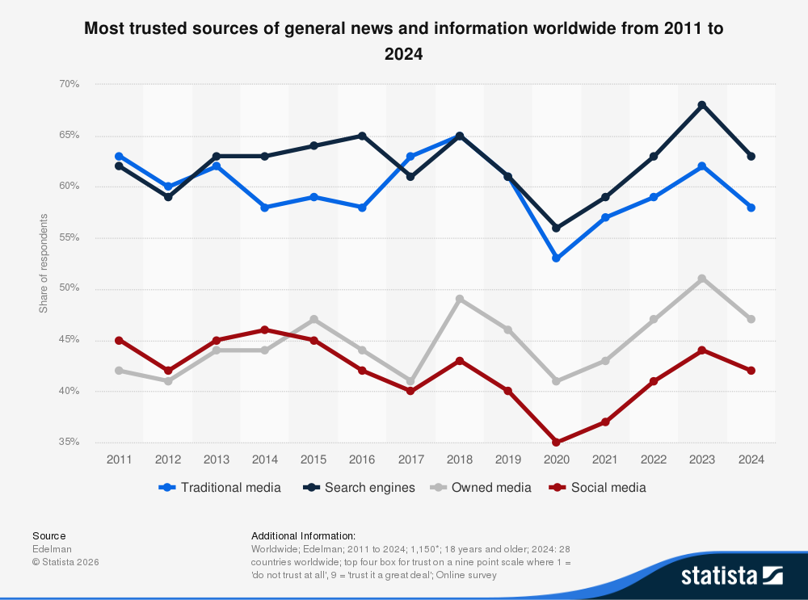
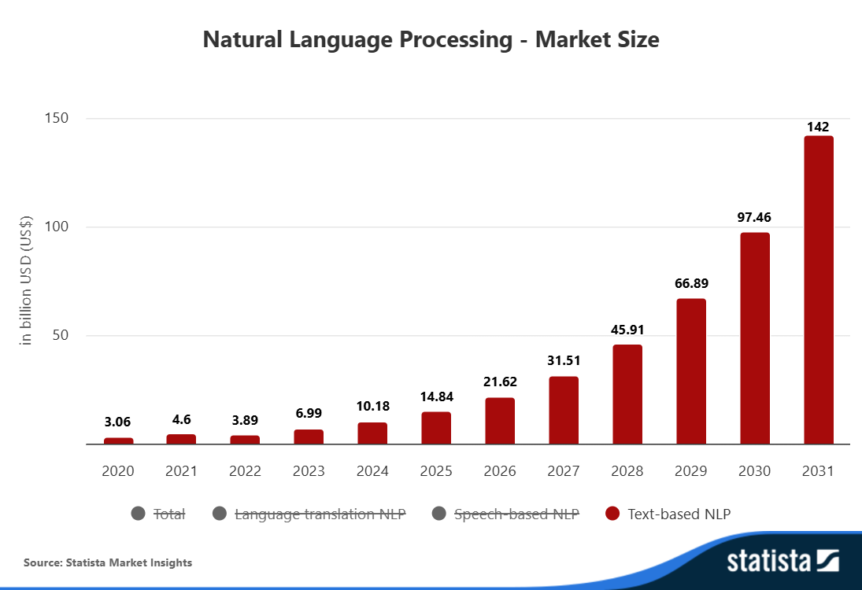
[1]
[2]

Slide 4
Initial plan and ideas
The dataset used is custom-built, consisting of 1000 articles from 10 news outlets chosen based on the ranking of AllSides’ “Media Bias Chart”
Preprocessing is convoluted, including converting text into lowercase, Unicode and whitespace normalisation as well as sentence and token segmentation, followed with other recommended techniques
Pipeline of machine learning approach used for this research project is complex and is shown in the next slide

Slide 5
Overview of the Machine Learning (ML) Pipeline
The initial ML pipeline developed for this research project is as follows:
Data Gathering/Acquisition
Preprocessing (Text Normalisation, Tokenisation, Noise Reduction, Lemmatisation)
Feature Engineering & Representation
Model Building, Training, and Optimisation
Evaluation and Analysis
Interpretation and Reporting of Empirical Results

Slide 6
Feature Engineering and Representation
Feature engineering includes introducing additional features into the data that is being processed.
For text data, features often added for prediction are the following:
TF-IDF Vectorisation
Part-of-Speech (POS) ratios
Pronoun Frequencies
Sentence Length Statistics

Slide 7
Model Building, Training, and Optimisation
This process includes building a model for binary classification
According to the initial plan, the following models will be used for prediction of the label of the data:
Logistic Regression with only TF-IDF features
Linear SVM with TF-IDF features as well as additional engineered features
Optimisation includes tuning hyperparameters used for the mentioned models, maximising accuracy/performance while minimising loss metrics

Slide 8
Evaluation and Analysis
The performance of the two classifiers is compared using paired statistical tests:
Monte Carlo permutation test (article level)
Applied to individual article predictions within each outlet
Tests whether observed differences in performance metrics (e.g., F1-score) could occur by chance
McNemar’s test (outlet level)
Applied to paired classification outcomes within each outlet
Evaluates whether one model consistently outperforms the other on the same articles
Additional details on test setup and assumptions are available upon request.

Slide 9
References
[1] https://www.statista.com/statistics/381455/most-trusted-sources-of-news-and-info-worldwide/
[2] https://www.statista.com/outlook/tmo/artificial-intelligence/natural-language-processing/worldwide?srsltid=AfmBOoopg3nhAOgCueZZXQrZ2QwNWLHmph_R0BiulWkcTnJJKOMc78ss

